Slide 1


<Insert Picture Here>
1 Strategy and Positioning

Slide 2
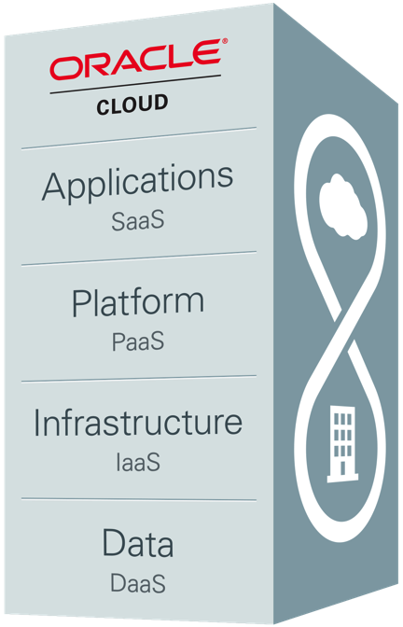
Oracle Strategy
Complete Stack
Complete Customer Choice
Best-of-breed
Open
Vertical Integration
Extreme Performance
Engineered Systems
On-premise
Private Cloud
Public Cloud
Hybrid Cloud
Notes:
Investing in R&D to deliver a complete suite of business capabilities to customers
Best-of-breed at every part of the technology stack
Open with a high degree of enterprise fit – if the customer’s got a heterogeneous environment, we can integrate.
Optimized systems/vertical integration – vertically integrate a customer’s portfolio to give the customer extreme performance and extremely stronger TCO.
Exadata, Exalogic, Exalytics, Database Apppliance, T4 SuperCluster, and Big Data Appliance are manifestations of this concept. There will be more
These are hardware and software engineered to work together
Engineered Systems is a game changing approach to simplify purpose built solutions for customers.
Oracle provides the complete technology stack—engineering, tuning, and collaboration is done at every level

Slide 3
What’s in a name ? Oracle Spatial and Graph
Reflects the importance of network-based operations.
Reflects the importance of semantic.

Slide 4
What is Spatial Data?
Business data that contains or describes location
Geographic features (roads, rivers, parks, etc.)
Assets (cell tower, fire hydrant, electrical transformer, etc.)
Sales data (sales territory, customer registration, etc.)
Street and postal address (customers, stores, factory, etc.)
Anything connected to a physical location
Almost every database contains some form of business data that can be leveraged using spatial technologies
Location is a “universal key”

Slide 5
Driving Forces
Smarter Customers
“Everyone” has a portable GPS – Handhelds/ Car Navigation
Use Google Maps, Use Google Earth
Web Interface automatic for customers & citizens
Maps provided for Properties, Traffic, Business Applications, …
Geoservices need to be Mission Critical
Available & Secure
999/112, Disaster mgmt, Power, Telcos, Water, Roads, …
“Track Anything that Moves – Anywhere, Anytime”
Know where it is
People, Equipment, Hospitals, Planes, Cars, Roads, Water
Growing Database sizes (TB->PB)
Long term Archives (keep things for ever!)
Aerial Photos, Satellite Images, Lidar

Slide 6
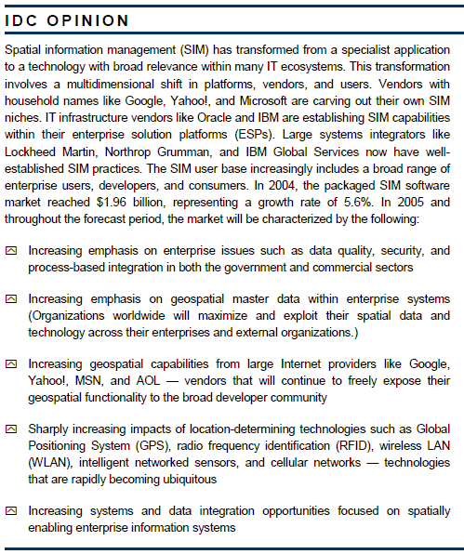
From Niche to Mainstream IT
Source: IDC report "Worldwide Spatial Information Management 2004-2008 Forecast and Analysis" #32073 Dec 2004

Slide 7




Spatial data and IT Coexistence or integration ?
Specialty Servers For Different Kinds Of Data
Data Isolation
Multiple proprietary formats
High Systems Admin and Management Costs
Scalability Problems
High Training Costs
Complex Support Problems
GIS
Enterprise IT
GIS
Applications
Database
Applications
Notes:
10
5
Geographical Information Systems are often separate from the «mainstream» IT systems of an organization. If they are coupled, this coupling tends to be rather loose.
A common architecture today is one that links the GIS side with the IT side by having so-called «attributes» stored in corporate databases (often Oracle). However, this has a number of drawbacks:
- development isolation: it is very difficult from either side to effectively use the information managed by the other side due to different interfaces, tools, etc and to the complexity of the subject matter.
- integration and deployment complexity: it is hard to maintain the integrity between graphics and attributes
Spatial data formats also suffer from two other major problems:
- each GIS tool typically uses its own proprietaty format(s). This makes it very difficult to use multiple tools and still share access to the same spatial data
- GIS formats are file-based. This severely limits the scalability of spatial systems. It also impacts issues such as security and access controls.

Slide 8
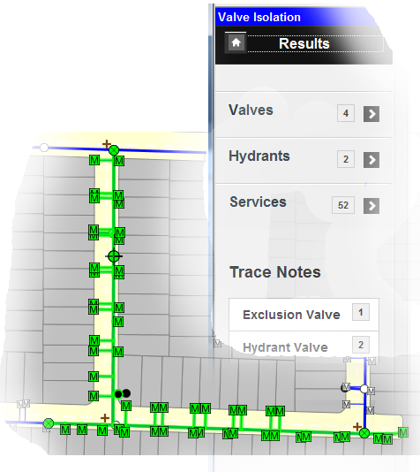
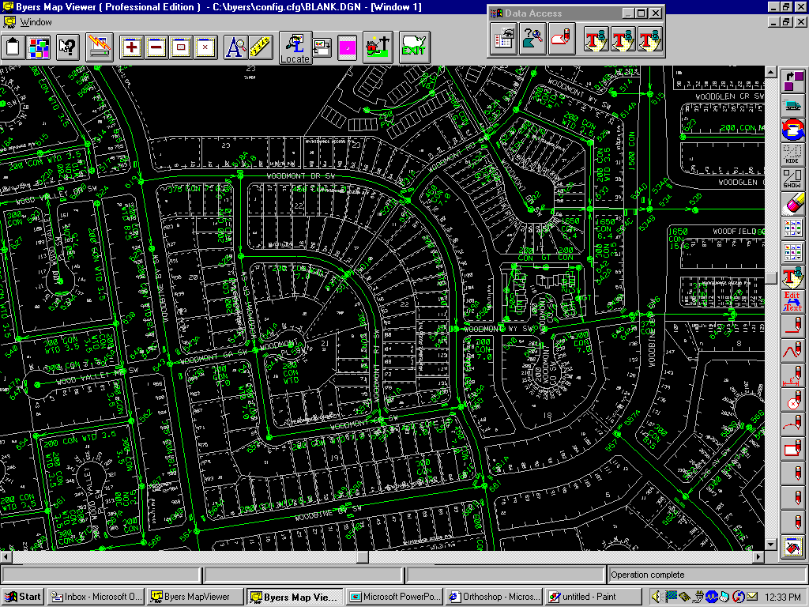
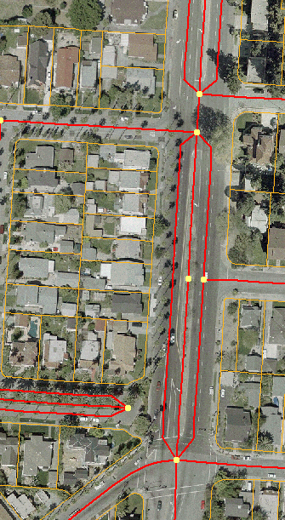

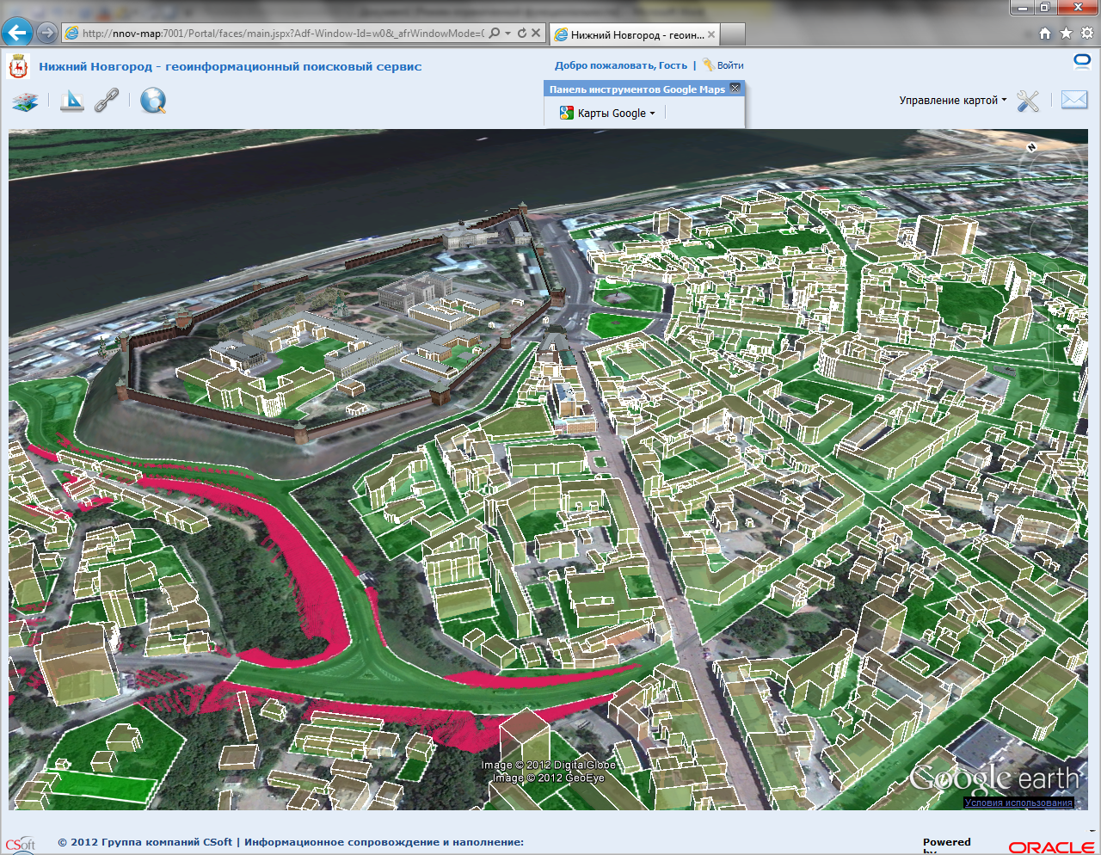
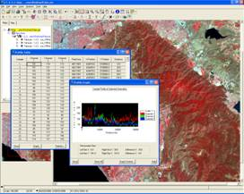
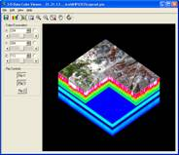
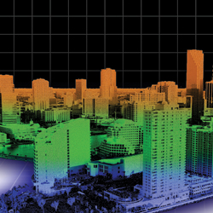
Specialist Applications
Geometry
Topology
Georaster
Networks
LRS
Geodetic
Long Transactions
3D
Lidar

Slide 9
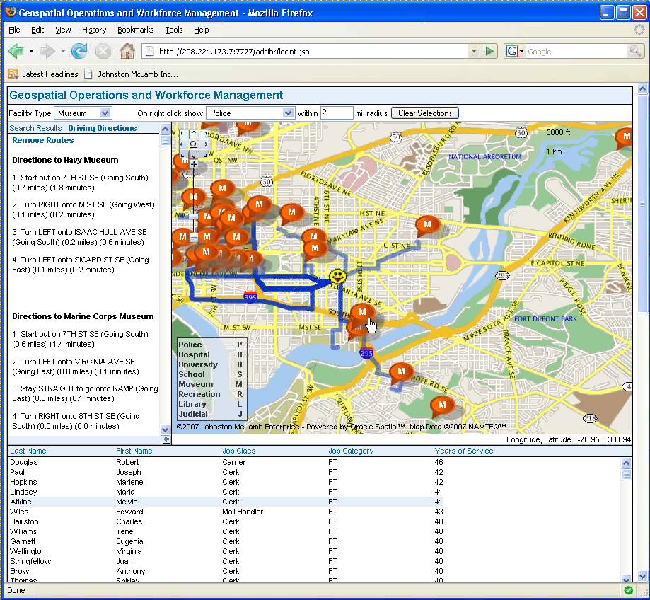
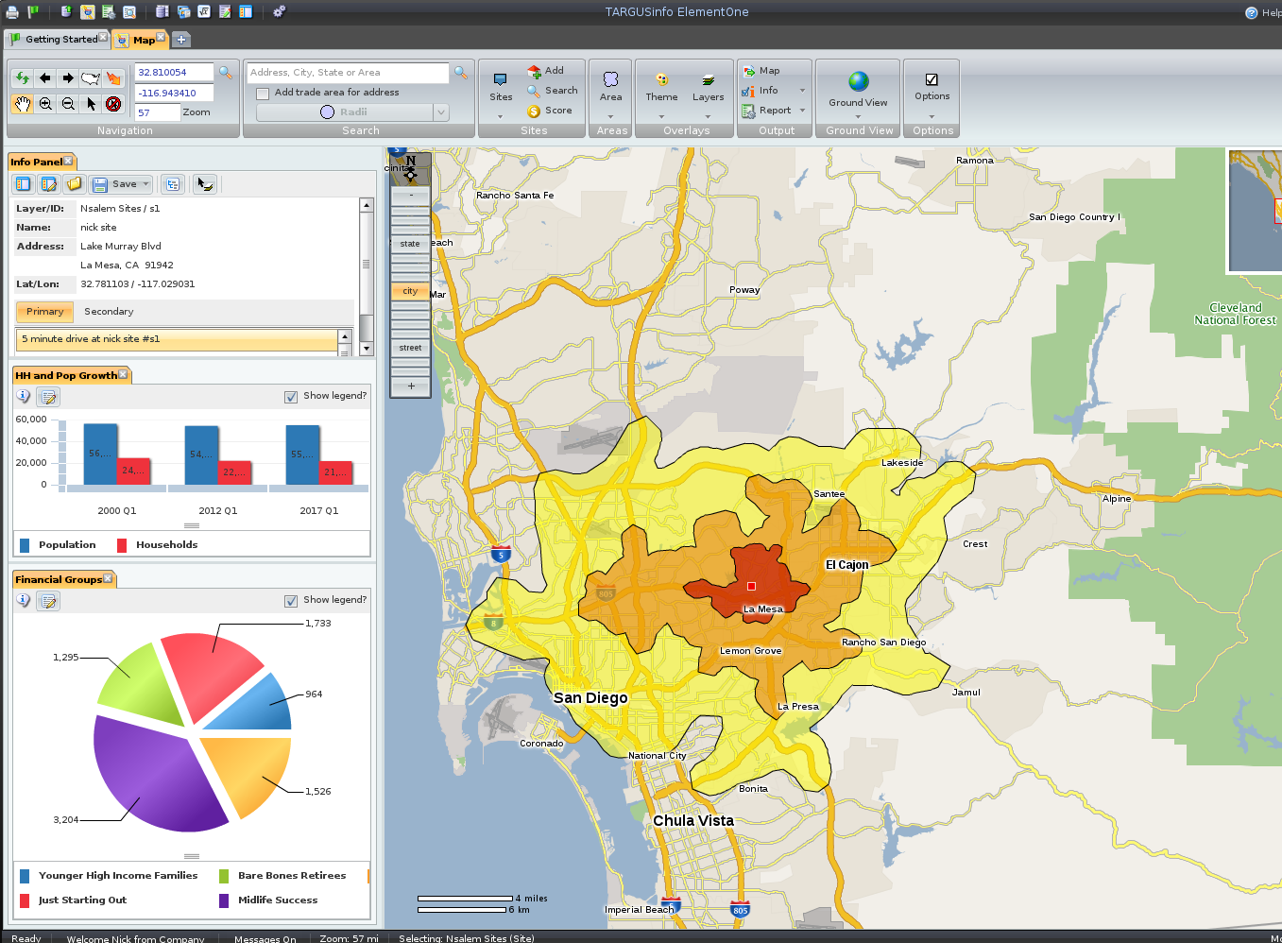
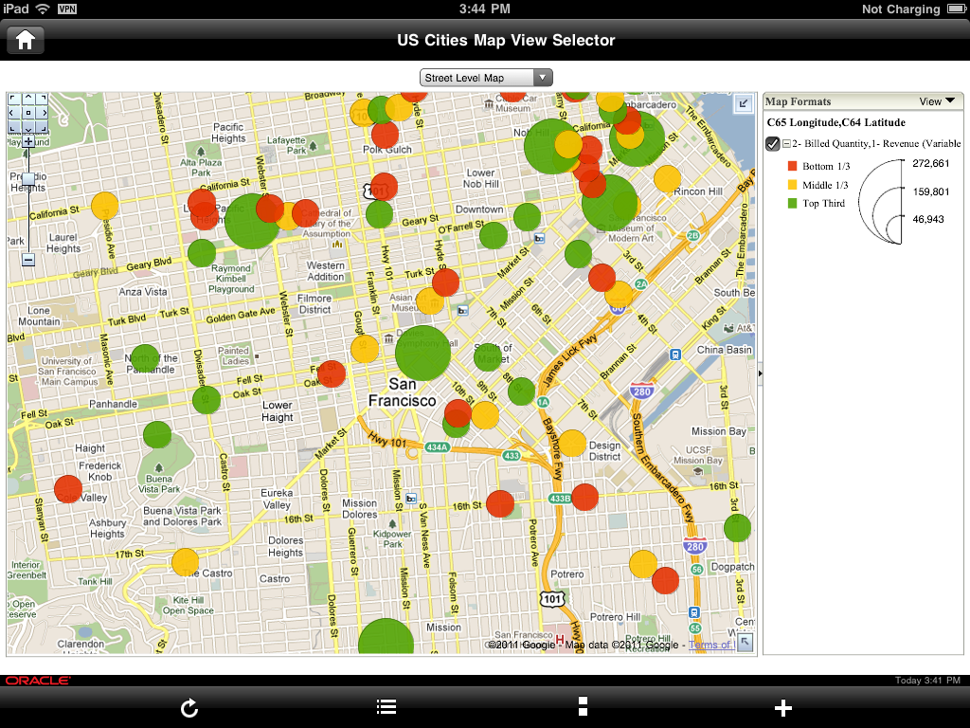
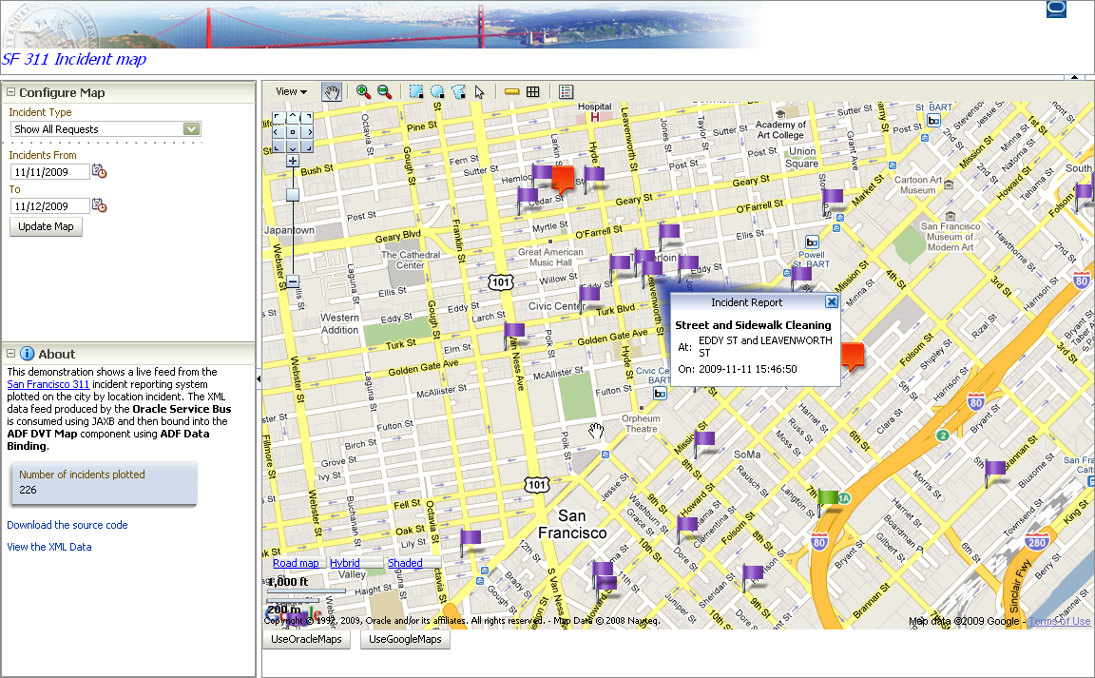
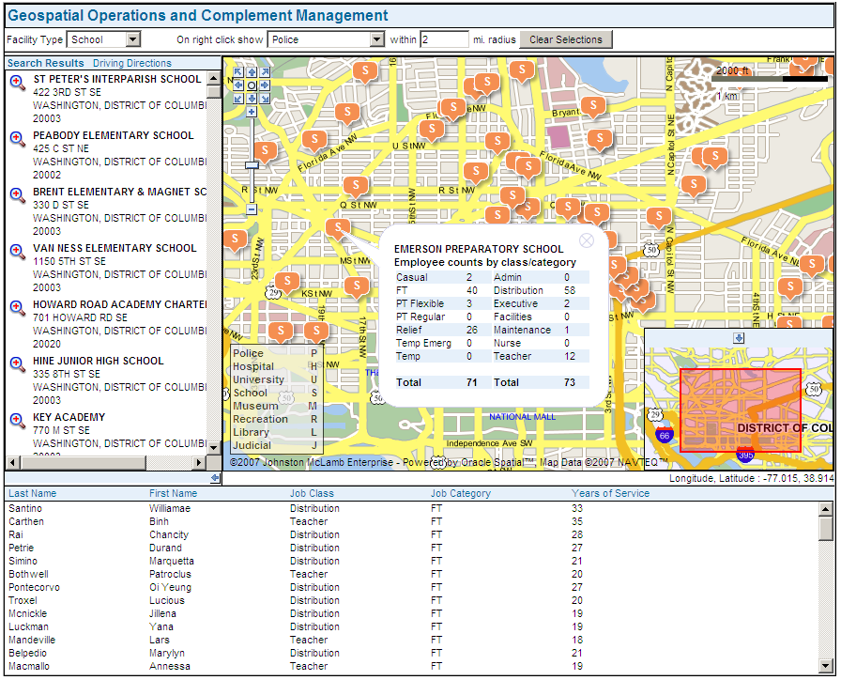
Location-Enabled Business Applications
Geocoding
Spatial searches
Routing
Mapping

Slide 10
Customers
Public Sector
Utilities
Transportation / Logistics
Retail
Finance
...

Slide 11
Application domains
Public sector
Land use, ownership and taxation (cadastre)
Infrastructure: roads, water, electricity
Public services
Public safety / emergency services
Statistics
Utilities
Network planning and operation
Transport and distribution networks
Plant safety – "Geo Fencing“
Integrate GIS with back-office (SAP, EBS)

Slide 12
Application domains
Commercial (retail, finance, etc)
Marketing: store location, customer behavior analysis("geo-marketing")
Real estate
Fleet management
Field service, CRM
“Pay-as-you-drive” insurance
Consumer
Location-based services
Friend-finder
Driving directions, navigation
Telematics

Slide 13
From GIS to Spatial to Location
Yesterday
Today
Application
Application
Application
Monolithic GIS
SQL
GML
WMS
WFS
...
Proprietary
APIs
Spatial Middleware
Open
APIs
Web Services
Spatially-aware Database
Traditional Database
Proprietary Storage

Slide 14






Our Strategy ...
Products
Oracle Spatial, Oracle Locator, Oracle Mapviewer
Partnerships With Leading Spatial Vendors
Software vendors, Integrators, Data suppliers
Commitment To Standards
Open Geospatial Consortium, SQL, ISO TC-211, TC-204
Integration with Oracle applications and tools
Exadata, Exalogic, Exalytics
Oracle BI Enterprise Edition, Fusion, e-Business, CRM,
Primavera, OTM, Utilities, Retail and more
Cloud
Available with DBCS (Database Cloud Service)

Slide 15

Where does Oracle fit in a Spatial/GIS System ?
Rendering
Storage
Analyse and Process
Capture
Data

Slide 16

Standard Database Services
Data Security
Replication
Transactional Integrity
Parallel Query
Bulk Load Utilities
Platform Independence
Online maintenance
Long transactions ...
A unified platform for all information
spatial and non-spatial

Slide 17
Key Technologies
Manage commercial and customer geospatial data (Oracle Database includes NAVTEQ boundary data for 60+ countries)
Data
Geocode
Convert addresses into coordinates
Analyze
Find Proximity, Location, Containment
Display
Add Maps & Reports to your Application
Notes:
Oracle now makes it easier than ever to spatially-enable your organization.
First, every Oracle Database now includes Navteq base map data, including state and county boundaries, cities and major roads, with worldwide coverage.
With Oracle Spatial, you can automatically geocode any business data with associated addresses…
…and perform sophisticated spatial analysis with spatial SQL queries and functions…
You can use Oracle MapViewer to display maps including your business data, and easily integrate spatial processing with your applications in Oracle’s service-oriented environment.
This effectively enables real-time spatial business intelligence.

Slide 18
Oracle Locator Oracle Spatial
Included in Oracle Database – All Editions
A cost option of Oracle Database Enterprise Edition
Support for all 2D geometry types
Points, lines, polygons
All Spatial Searches
Spatial processing: measurements, buffer, centroid, overlays, affine transforms, ….
Spatial aggregates
Utility, tuning and validation functions
Full Coordinate Systems support
Includes all Locator features +
Spatial Vector Accelerator
3D objects (points, lines, faces, solids)
3D types (point clouds, TINs)
Generic curves (NURBS)
Linear Referencing
Raster storage and processing
Geocoding
Network tracing and searching
Routing
Persistent Topology
OGC Web Services (WFS, CSW, OpenLS)

Slide 19

Spatial vs. Locator
12c Release 1
All functions in SDO_GEOM package are now in Oracle Locator !
SDO_UNION
SDO_INTERSECTION
etc
All aggregate functions
SDO_AGGR_UNION
SDO_AGGR_CENTROID
etc

Slide 20
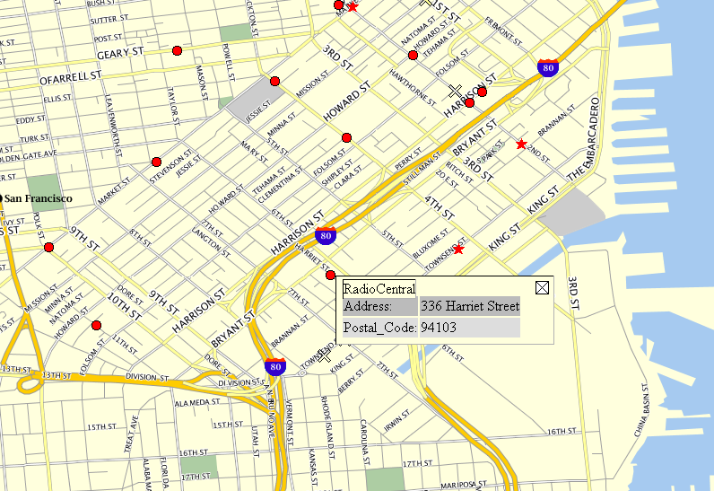
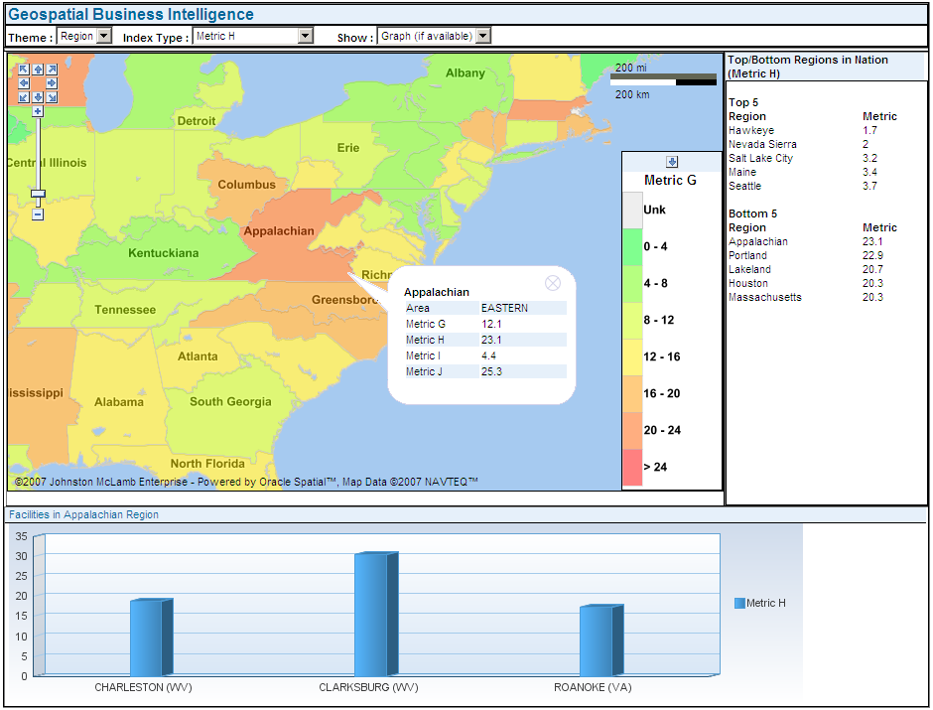
Oracle MapViewer
Feature of Oracle Fusion Middleware
Standards-based J2EE and Java Server Faces component
XML/HTTP, Java/AJAX
Publish spatial data to the web
Map and feature cache provides smooth scroll (pan, zoom)
Rich Java, XML, JavaScript APIs provide client side interactivity using HTML5 facilities.
Centrally managed map definitions, symbology, and styling rules
Notes:
We have discussed the storage and management of spatial data. Users also need a way to visualize it.
Oracle provides a technology called MapViewer for this purpose.
MapViewer is a feature of Oracle Fusion Middleware Application Server. It is a web mapping toolkit (not an end-user application), for visualizing map data stored in Locator or Spatial, and use it in reporting applications, enterprise applications such as BI analytics
Its main features include
Standards support: XML/HTTP, Java/AJAX – for highly interactive web maps that update automatically without manual browser refreshes
Client-side API to interact with those maps
Map Cache – seamless pan & zoom, made popular by Google Maps
Map Builder tool: to define what is displayed & how it is displayed on the map

Slide 21
Oracle MapViewer - Licensing
Included in every Oracle Fusion Middleware edition
For use with other application servers (JBoss, Tomcat), you need to license “Oracle TopLink and Application Development Framework”
See http://www.oracle.com/technetwork/middleware/mapviewer/j2ee-server-support-097757.html for the list of supported application servers
Works with any database edition (SE1, SE, EE)
Works with any database version (12c, 11g, 10g, 9i)
Notes:
We have discussed the storage and management of spatial data. Users also need a way to visualize it.
Oracle provides a technology called MapViewer for this purpose.
MapViewer is a feature of Oracle Fusion Middleware Application Server. It is a web mapping toolkit (not an end-user application), for visualizing map data stored in Locator or Spatial, and use it in reporting applications, enterprise applications such as BI analytics
Its main features include
Standards support: XML/HTTP, Java/AJAX – for highly interactive web maps that update automatically without manual browser refreshes
Client-side API to interact with those maps
Map Cache – seamless pan & zoom, made popular by Google Maps
Map Builder tool: to define what is displayed & how it is displayed on the map

Slide 22
A Long History
Oracle 12c
Generic curves, Raster algebra, Vector accelerator
Oracle 11g
3D support, Solid modelling
Web services
Oracle 10g
Raster, Topology, Network modelling
Spatial Mining, MapViewer
Oracle 9i
Replication, partitioning,
Spatial aggregation, Geodetic coordinates …
Oracle 8i
Oracle 8.0.4
Spatial
Cartridge
Spatial Data Type, Spatial Operators
Linear Referencing, Coordinate Transformation
Long transactions ...
Oracle 7.3.3
Spatial Data
Option
Points, Lines, Polygons
Spatial Operators
40% Faster Performance
Oracle 7.1.6
Multi Dimension
Points, Lines, Polygons
Spatial Operators
Points Only
1994 1995 1996 1997 1998 1999 2000 2001 2003 2004 2005 2007 2013 2017

Slide 23










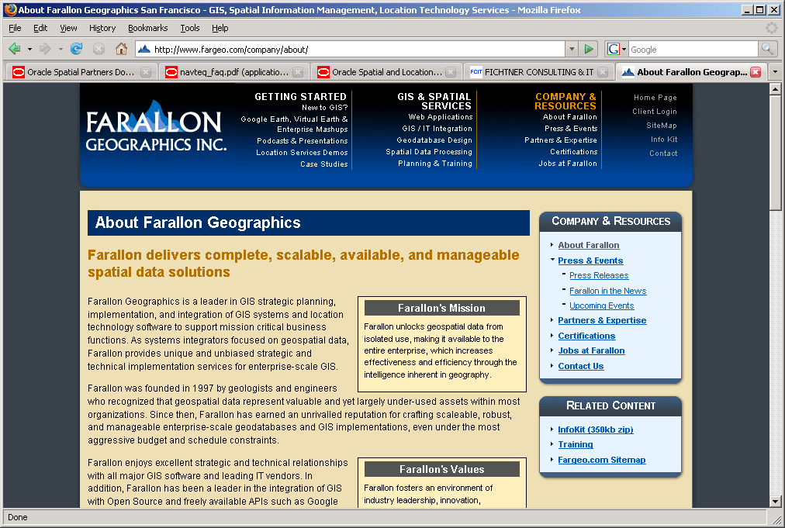





















Oracle Spatial Partners
Geospatial Tool Providers
Specialty Systems Integrators
Data Providers
NAVIGATE
http://www.oracle.com/technetwork/database/options/spatial/community/partners/index.html
Notes:
Industry support for Oracle Spatial and its standards-based SOA environment continues to grow. There is an active Oracle spatial user group, and a large and growing ecosystem of Oracle Spatial partners including all of the leading geospatial, mapping and location services technology vendors.
Leading systems integrators provide Oracle Spatial-based services. You have many choices for expert, quick deployment of the right customized solution to meet your specific requirements – from location-enabled business applications to the most specialized GIS systems. This slide shows a sampling of some of the leading tool providers, SIs, and data providers. A more extensive list of partners is available at oracle.com/technology/products/spatial.
ok
1/5/98

Slide 24










Open Source Tools
http://www.oracle.com/technology/products/spatial/htdocs/spatial_opensource.html

Slide 25
Database Editions
Editions
Express
Standard One
Standard
Enterprise
Differences
Supported server architectures (number of processors)
Minimal number of users (if per-user licensing)
Supported features
Details of features in each edition
http://www.oracle.com/database/product_editions.html

Slide 26
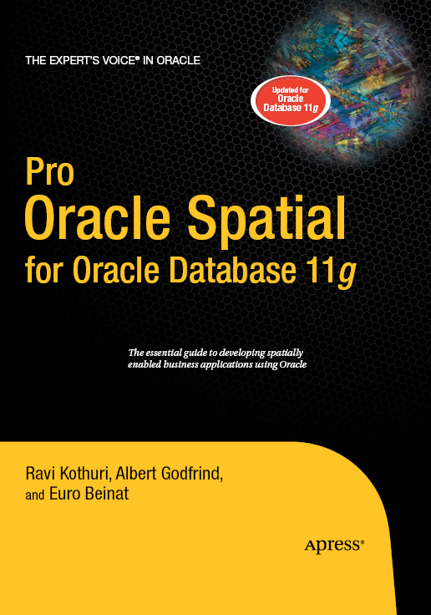
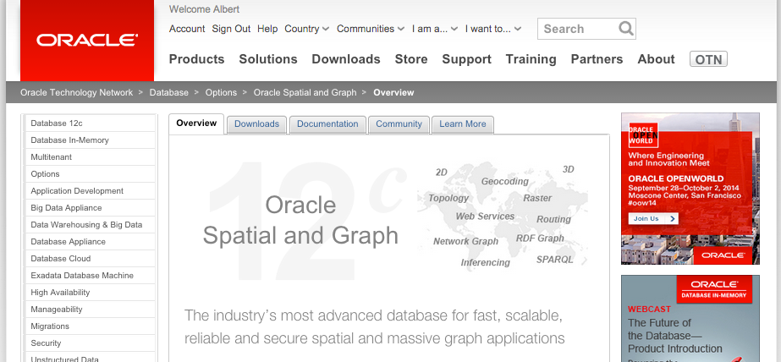
Resources
http://www.oracle.com/technetwork/database/options/spatial
Examples, white papers, downloads, discussion forum, sample data ....

Slide 27
Resources
References, testimonials, case studies | http://www.oracle.com/database/spatial.html
Spatial technology: white papers, tools, sample code, partner tools and data, forum | http://www.oracle.com/technology/products/spatial
Mapviewer: downloads and documentation, forum, papers | http://www.oracle.com/technology/products/mapviewer
Sample Code Repository | http://www.oracle.com/technetwork/indexes/samplecode/spatial-1433316.html
Knowledge zone and specialization | http://www.oracle.com/partners/en/knowledge-zone/database/spatial-1534087.html
Workspace Manager | http://www.oracle.com/technology/products/database/workspace_manager
Oracle Maps (eLocation) | http://maps.oracle.com
Oracle Spatial Forum | http://forums.oracle.com/forums/forum.jspa?forumID=76
Oracle Mapviewer Forum | http://forums.oracle.com/forums/forum.jspa?forumID=727

Slide 28
More Resources
Database editions, features and options | http://download.oracle.com/docs/cd/E11882_01/license.112/e10594/toc.htm http://www.oracle.com/us/products/database/product-editions-066501.html
Upgrading database versions | http://www.oracle.com/technetwork/database/upgrade/index-088044.html
Pre-build Virtual Images (Needs Oracle Virtual Box) | http://www.oracle.com/technetwork/community/developer-vm/index.html
Bernhard Fischer-Wasels Oracle specialist from Germany | http://oracle-maps.blogspot.com/
Simon Greener Independent consultant, Australia | http://www.spatialdbadvisor.com/oracle_spatial_tips_tricks
Liujian (LJ) Qian Oracle - Development manager of MapViewer | http://oraclemaps.blogspot.com/

Slide 29

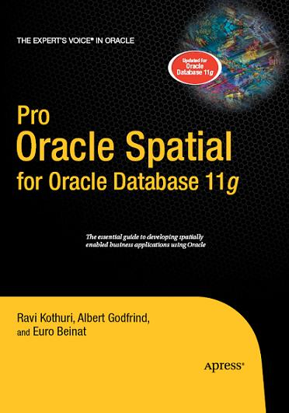

Suggested Reading Material
Expert One-on-One Oracle, Tom Kyte, Apress
ISBN 978-1-43022-946-9
Pro Oracle Spatial, Ravi Kothuri, Albert Godfrind, Euro Beinat, Apress, 2007
ISBN 978-1-59059-899-3
Optimizing Oracle Performance, Cary Millsap, O’Reilly,
ISBN 978-0-59600-527-6

Slide 30

ALBERT GODFRIND
Spatial and Graph Solutions Architect
Oracle Corporation
Les Algorithmes
2000 Route des Lucioles
06410 Biot-Sophia-Antipolis
France
phone +33 4 37.43.47.27
mobile +33 6 09.97.27.23
albert.godfrind@oracle.com
http://www.oracle.com/

